Slide 1
Professor
Jorge Alfonso Meléndez Acuña

Slide 2
Welcome

Slide 3
Schedule
Network Science for Data Analytics
Unit 1
Introduction to Network Analysis
Unit 2
Centrality
Measures
Unit 3
Introduction to Network Models
Unit 4
Community Detection
Unit 5
Error and Attack Tolerance
Unit 6
Graph Machine Learning
Introduction to
Data Science
Basic Concepts of Graph Theory
Hubs
Communities
Vulnerability in networks
Machine Learning with Graphs
Introduction to Network Science
Small Worlds
Network Models
Deep Learning with Graphs

Slide 4
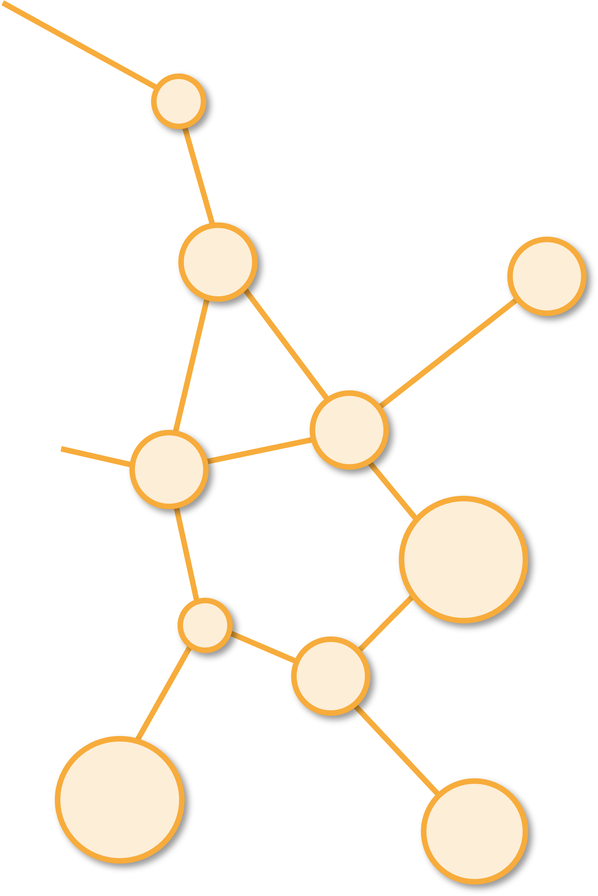
Introduction to Network Models
Unit 3

Slide 5
Outline

Slide 6

Global Measures of a Network(Graph)
Link to Model

Slide 7
Why Global Measures?
How robust is a network to attacks or failures?
How long does information travel in a network?
How centralized is a network?
How many clusters does a network have? (Communities)

Slide 8
Global Measures (Pros and Cons)
What does it mean that a network is well connected?

Slide 9
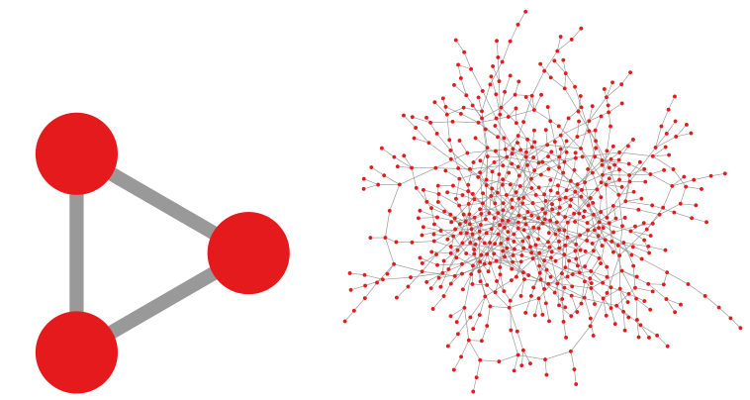
1. Average Degree
Sparsely Connected: 650 nodes
Fully Connected
Average Degree = 2

Slide 10
2. Density
To quantify the difference between these two cases, network scientists defined the concept of network density
The density of a network seems to go down as you increase the number of nodes
Density = 100%
Density = 0.31%
n(n-1)/2=650 ∗ 649/2 = 210, 925

Slide 11
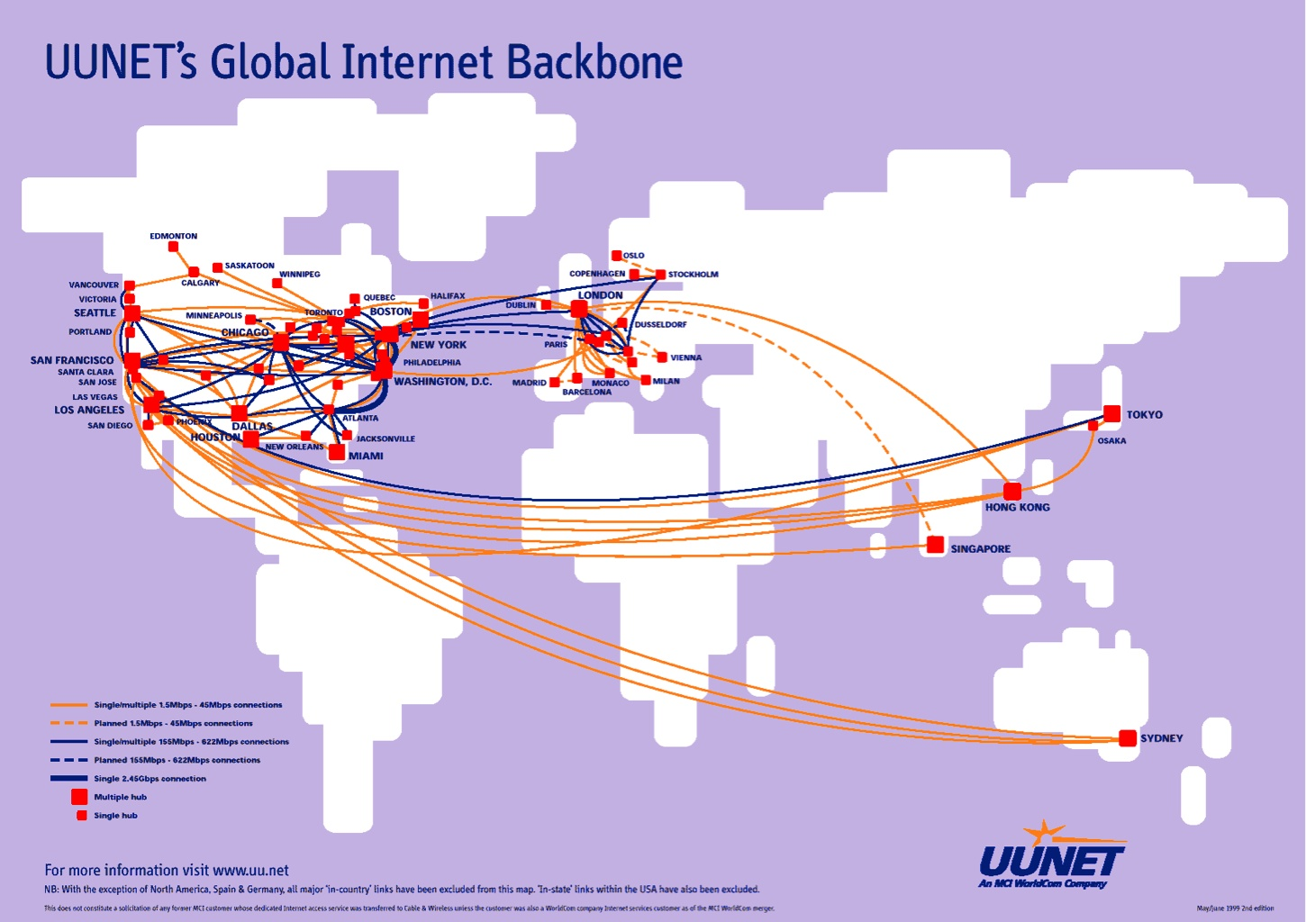
Real Networks are Sparse
Routers forming the backbone of the Internet
It contains |V| = 192, 244 nodes. So, the possible number of edges is: |V|(|V| − 1)/2 = 18, 478, 781, 646
How many edges does it really have? 609, 066
Just 0.003% of the maximum
Density Backbone of the Internet: 0.003%

Slide 12
Real networks are Sparse
L << L_{max} (L: number of edges/links) or
<k> << N-1 (<k>: average degree)
WWW (ND Sample): N=325,729; L=1.4 10⁶ L_{max}=10¹² <k>=4.51
Protein (S. Cerevisiae): N= 1,870; L=4,470 L_{max}=10⁷ <k>=2.39
Coauthorship (Math): N= 70,975; L=2 10⁵ L_{max}=3 10¹⁰ <k>=3.9
Movie Actors: N=212,250; L=6 10⁶ L_{max}=1.8 10¹³ <k>=28.78
Reference: Albert, Barabasi, RMP2002.

Slide 13
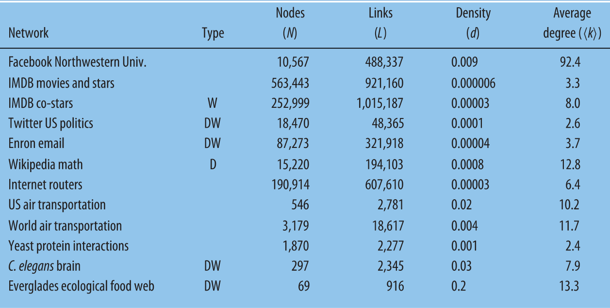
Density and Average Degree of Important Networks
Correlation between Density and Average Degree?

Slide 14
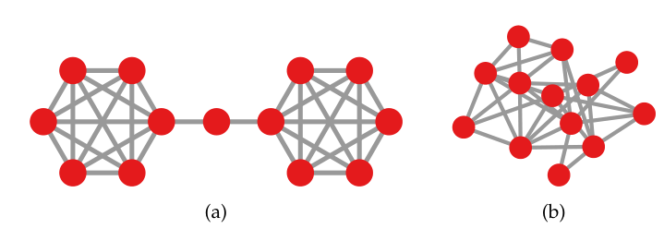
3. Clustering Coefficient
Density does not solve all ambiguities in the case of the average degree.
Two networks can have the same density and the same number of nodes but may look very different from each other.
Nodes: 13
Edges: 32
That is why network scientists created a new measure:
the clustering coefficient

Slide 15
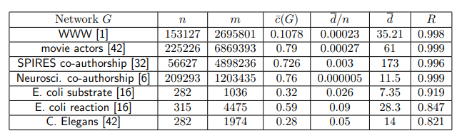
Question:
If average degrees are low and networks are sparse, would not you expect real world networks to have a low clustering coefficient too?
The opposite holds: real world networks are clustered.

Slide 16
Answer
This means that these networks might have few connections per node, but these connections tend to be clustered in the same neighborhood.
Nodes tend to close triangles.
This is especially true for social systems.

Slide 17
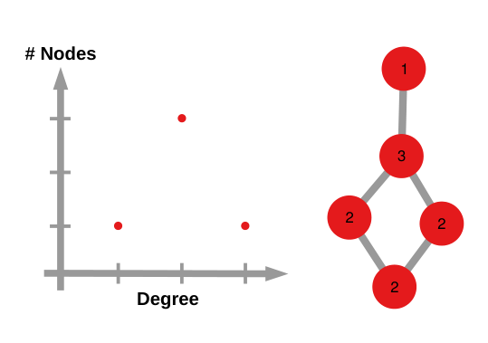
Degree Distribution
Looking at the degree distribution of a network can shed light on surprising properties.
What is a degree distribution?
It is just a degree scatter plot: the number of nodes with a particular degree
Scatter Plot

Slide 18
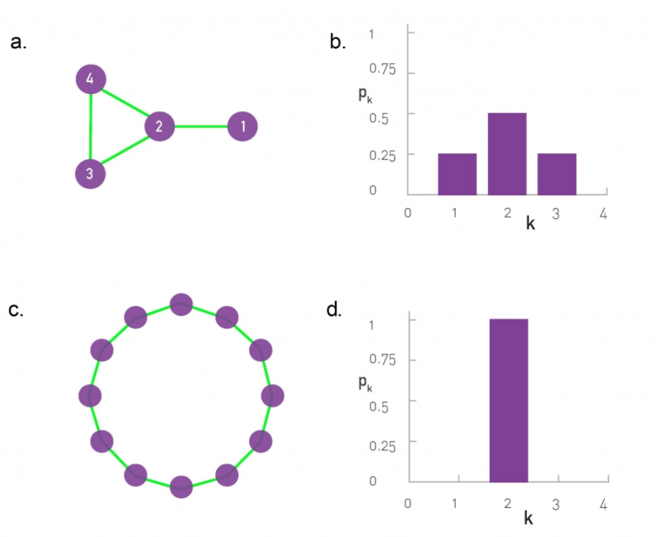
Degree Distribution

Slide 19
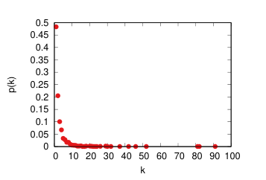
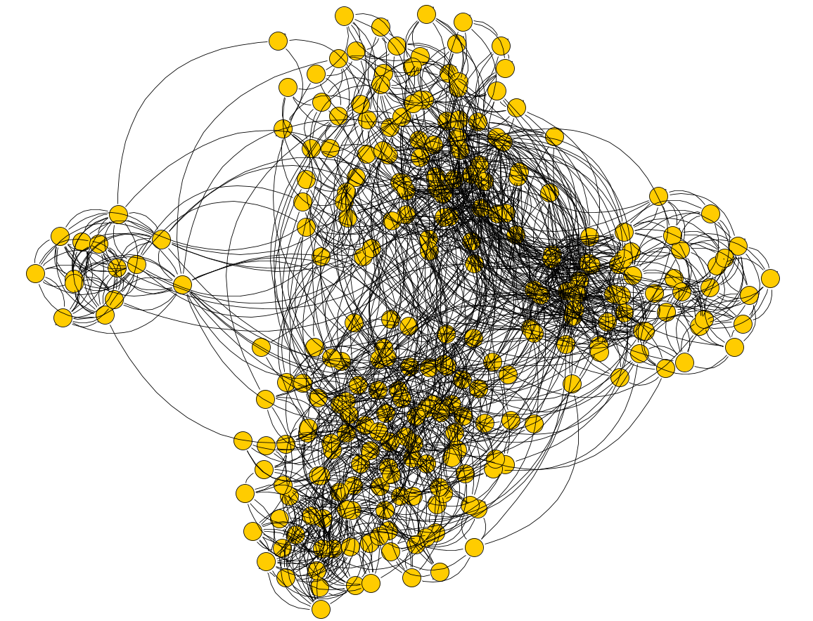
Degree Distribution
Protein-Protein
Values of the y axis are normalized by dividing its values by the number of nodes in the network.
The y axis is the probability of a node to have a degree equal to k.
This makes it easier to compare two networks with different node count.

Slide 20
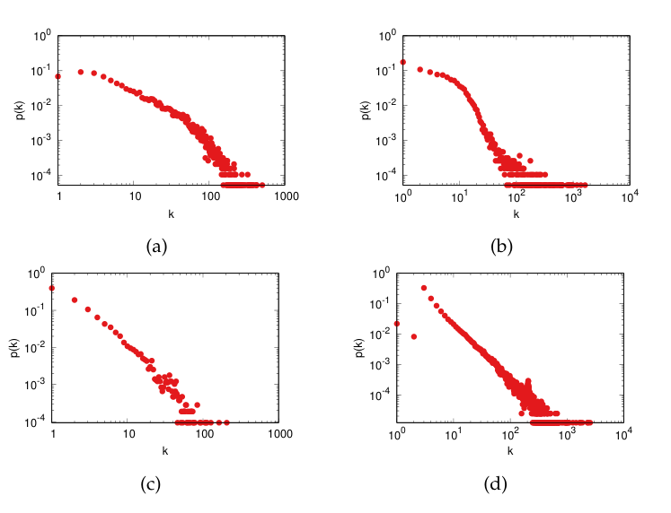
The degree distribution of some real world networks
(a) coauthorship in scientific publications [Leskovec et al., 2007b];
(b) coappearance of characters in the same comic book [Alberich et al., 2002];
(c) interactions of trust between PGP users [Boguñá et al., 2004];
(d) connections through the Slashdot platform [Leskovec et al., 2009].

Slide 21
Shortest Paths
The degree is the most direct measure of importance of a node in a network.
The more connections a node has, the more important it is. However, there are alternative ways to estimate the importance of a node
Sometimes, it does not matter how many connections you have, but how many nodes can be reached by passing through you. In social networks, how many people someone can reach by passing through you.
A significant chunk of measures of node importance are based on the concept of shortest paths.

Slide 22
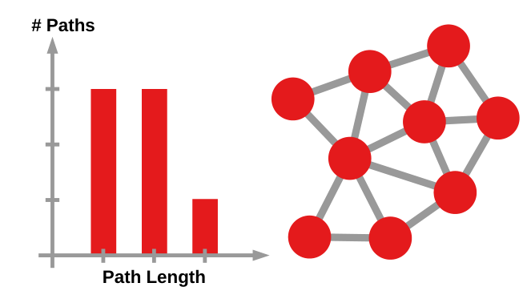
Shortest Paths
Just like with the degree, knowing the length distribution of all shortest paths in the network conveys a lot of information about its connectivity.

Slide 23
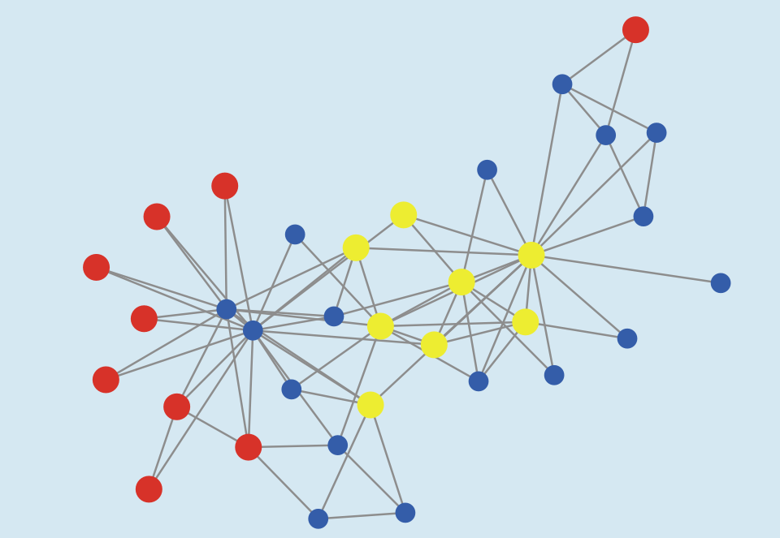
Shortest Paths
Yellow: core Red: Periphery
A tight distribution with little deviation implies that all nodes are more or less at the same distance from the average node in the network.
A spread out distribution implies that some nodes are in a far out periphery and others are deeply embedded in a core.

Slide 24
Diameter
The rightmost column of the histogram is important.
It records the number of shortest paths of maximum length.
These are the “longest shortest paths”
We call it the diameter of the network
It is the worst case for reachability in the network
It is a measure of the maximum possible separation between two nodes.

Slide 25
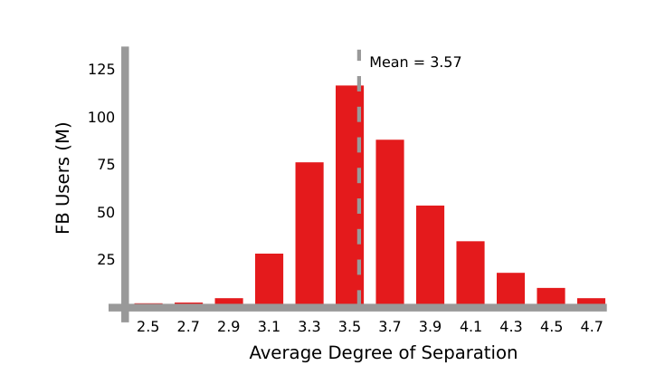
Facebook 2012
The path length distribution for Facebook in 2012.
A remarkable thing is how ridiculously short the paths are even in such a gigantic network.

Slide 26

Average shortest path length (APL)
In general, we want to know the typical case for nodes in the network.
What we calculate, then, is not the longest shortest path, but the typical path length, which is the average of all shortest path lengths
The most notorious enunciation of the surprising small average:
Path length in large networks is the famous “six degrees of separation”

Slide 27
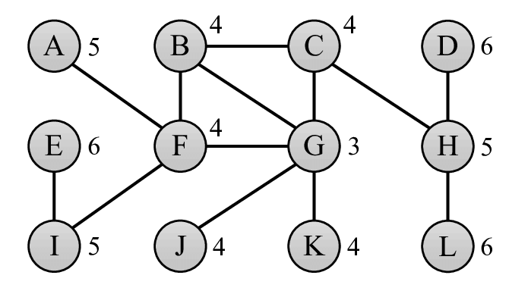
Related Measures
Eccentricity
It is defined for each node.
It gives the maximal shortest path length a node can have with any other node in the network

Slide 28
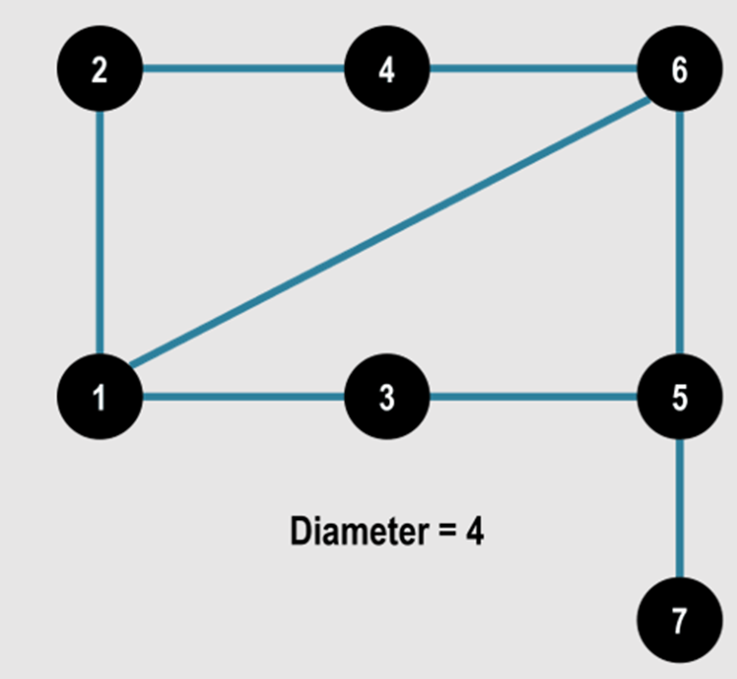
Related Measures
Diameter (D)
Maximal eccentricity in a network
How far two nodes in a network can be
Thos nodes whose eccentricity is D are called peripherical nodes.

Slide 29
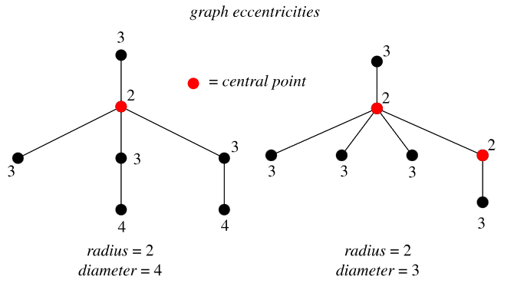
Related Measures
Radius (R)
Minimal eccentricity in a network
Smallest number of steps to reach every node starting from an optimal node.
Nodes whose eccentricity is R are called core nodes.

Slide 30
Complete Model
Link to Model

Slide 31
Good bye

Slide 32
References

Slide 33
Image copyright

Slide 34
Credits
Subject Matter Expert
Instructional Designer
Jorge Alfonso Meléndez Acuña
Angela Maria Arboleda Restrepo
Subject Matter Expert
Graphic Designer
Luis Fernando Niño Vásquez
Tania Valentina Flórez Rincón
First version
Date: April 2025

